Slide 1
MemorAI
Alice Hua
W210 Capstone Idea - Fall 2021

Slide 2
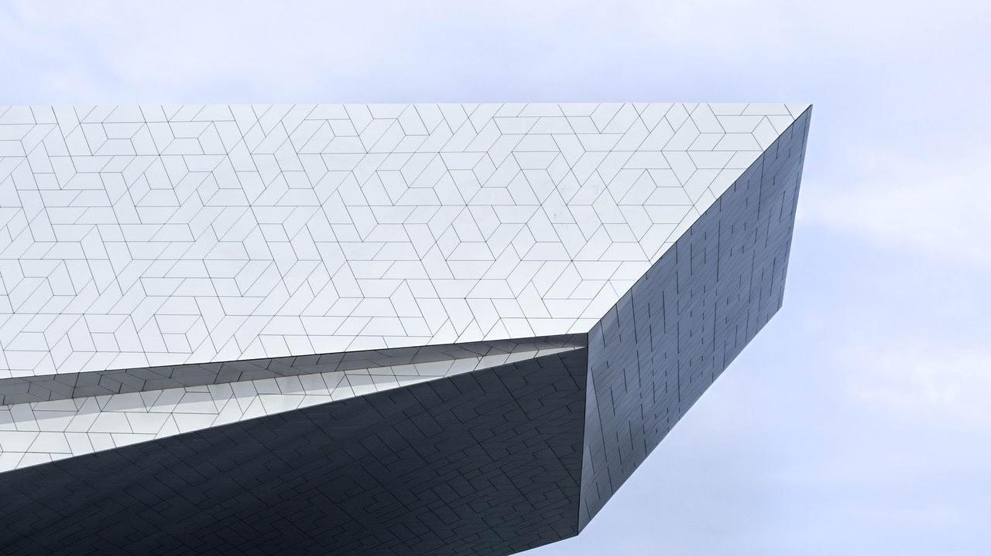
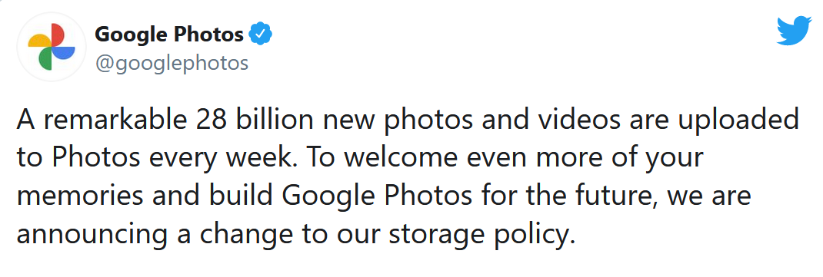
Motivation
28,000,000,000
Nov 11, 2020
https://twitter.com/googlephotos/status/1326586062831955968?lang=en

Slide 3
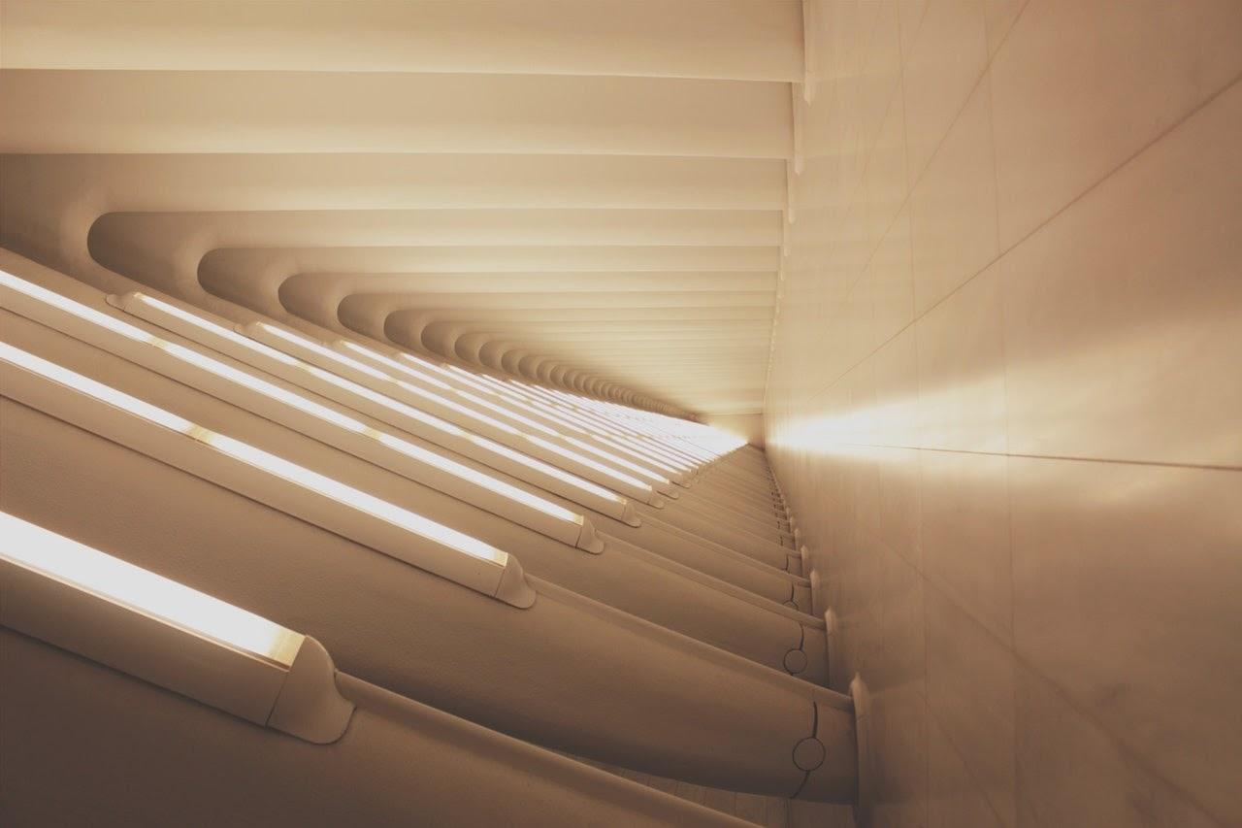


Motivation
👪 💑
☁
Notes:
With our family members spread across the globe and current Covid-19 policies, we never know when and where we’ll get to see them in-person again.
Now, weekly zooms and smart technologies are recreating our human connection experience.
Ironically, the concern of human disconnection due to increased technology usage is now replaced with a heavy dependency on them for re-connecting with our loved ones.
And for our elderly family members or those who our time with them is precious, we would like to remember them when they are gone, whether that is halfway across the globe or no longer on Earth.

Slide 4

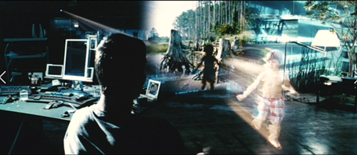
Research Question
Product: Does this service create stronger relationships or family bonds? Will they be likely to sign up for an annual membership?
Technical: Will a unified model like MultiModel that draws on vision, language and audio networks be capable of performing well across multiple domains including image and speech recognition?
Minority Report (2002)
Notes:
Our proposed research question is inspired by the movie Minority Report where Tom Cruise gets to see fleeting moments of his son in a holographic representation in the middle of the night where he misses him the most.

Slide 5
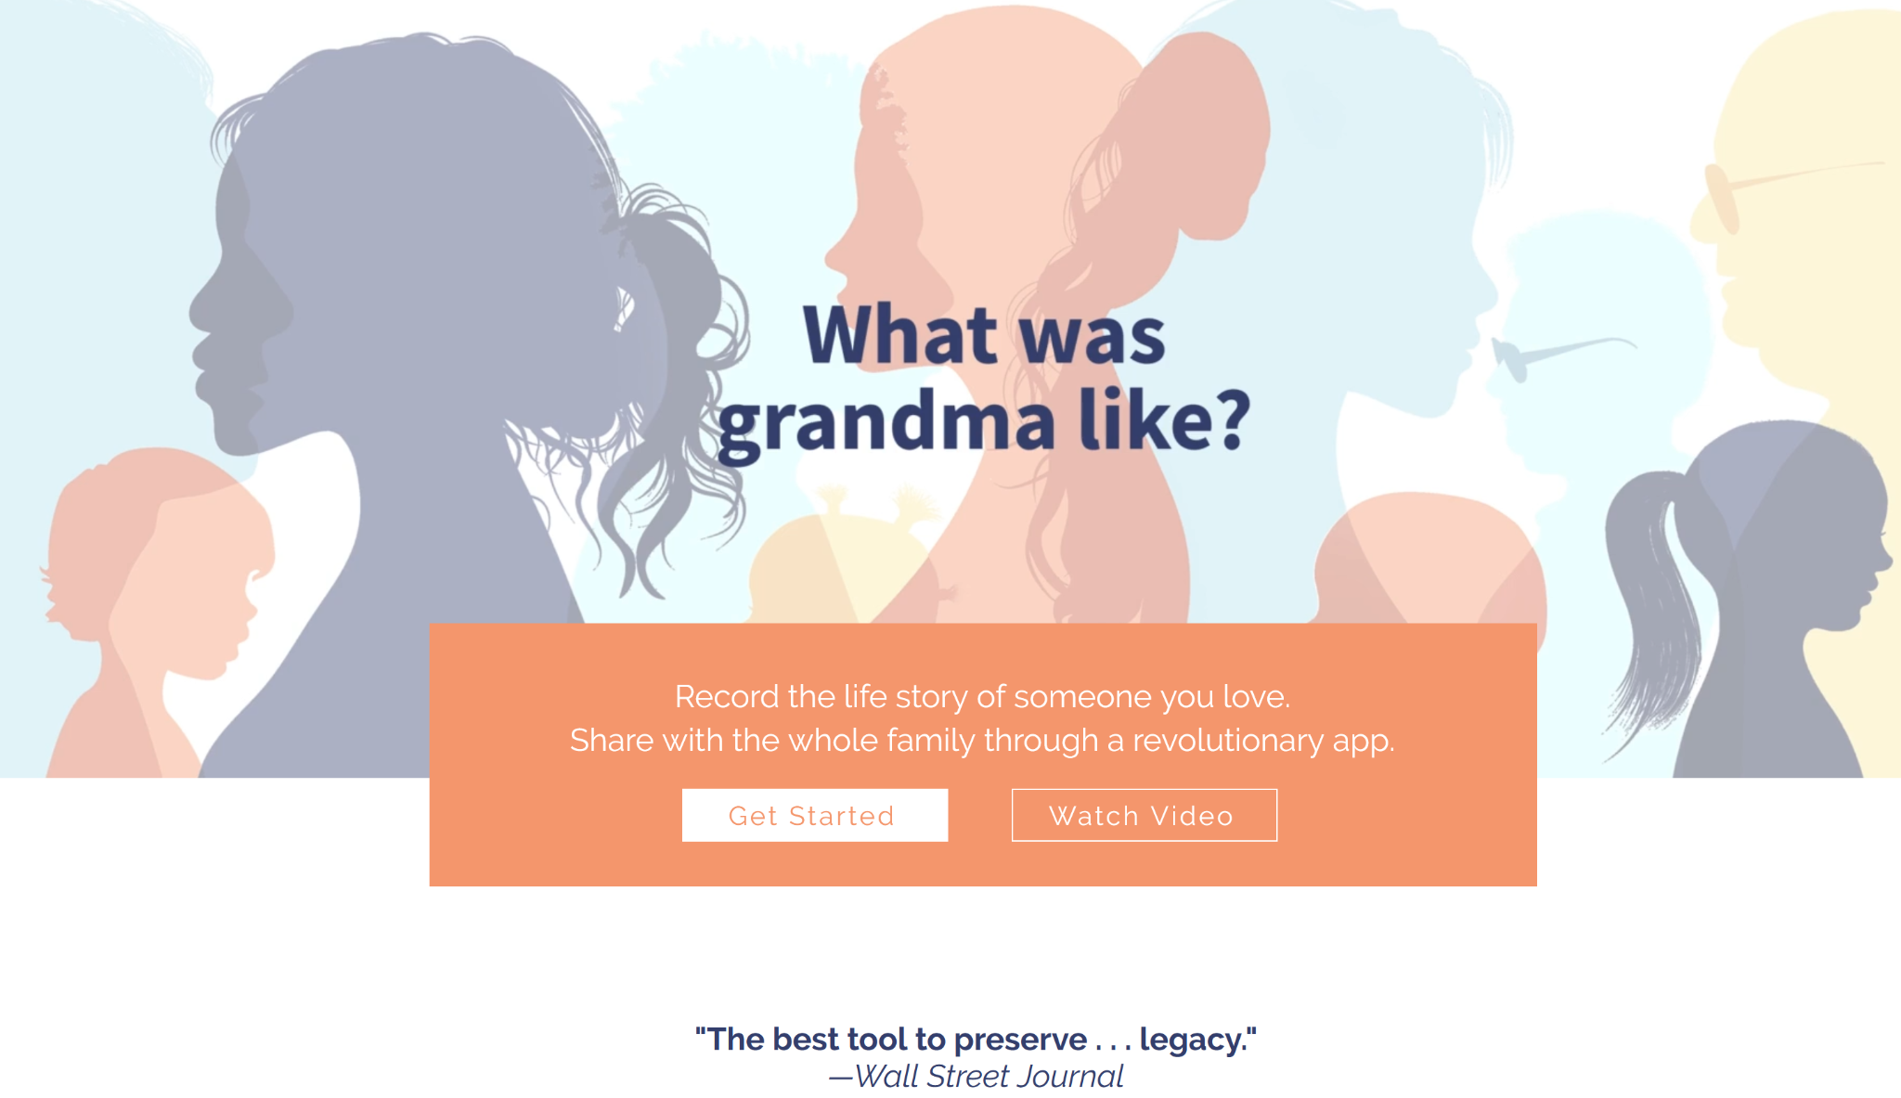
Proposed Partnership
HereAfter.ai
Notes:
I’m proposing a partnership with the Berkeley Skydeck incubator startup called HereAfter.ai, a legacy service whose mission is most similar to my idea.
I spoke to James (CEO) and Kevin (CTO) about their current technology, what they’re doing is a lot like Q&A with Alexa, but using your loved one’s voice.
The process works by first having an interview with your loved one whose stories are recorded, then later used to answer your questions about their lives.
Our next meeting will be on Monday 9/3/2021 where we will go over the scope and possibilities of creating a prototype which I’m hoping to use photos and videos for revisiting their stories

Slide 6
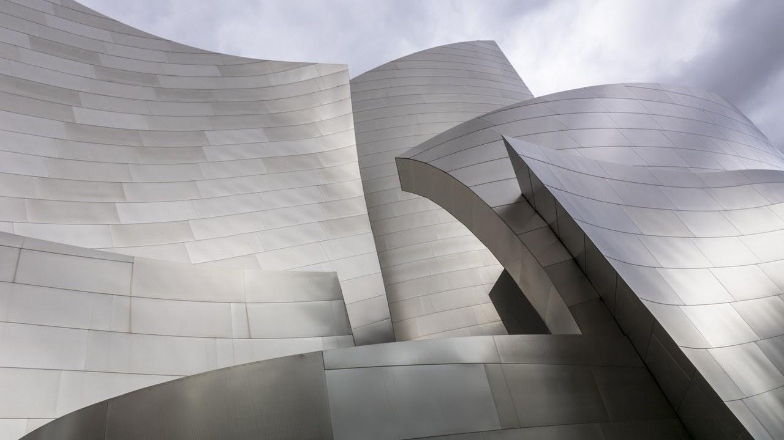



Proposed Data
Three Primary Data Sources:
Production
Photos, videos, and media from family and friends (crowdsourcing & human in the loop)
Internet footprint and social media of the individual
Capstone Project
bAbi - for story, question and answer
ImageNet - popular CV dataset for object detection
IMDB-Wiki - for age and gender estimation if human in the loop is missing
Kinetics-700 - for human-focus actions, expect scraping videos from provided URLs and labels
Notes:
The d

Slide 7
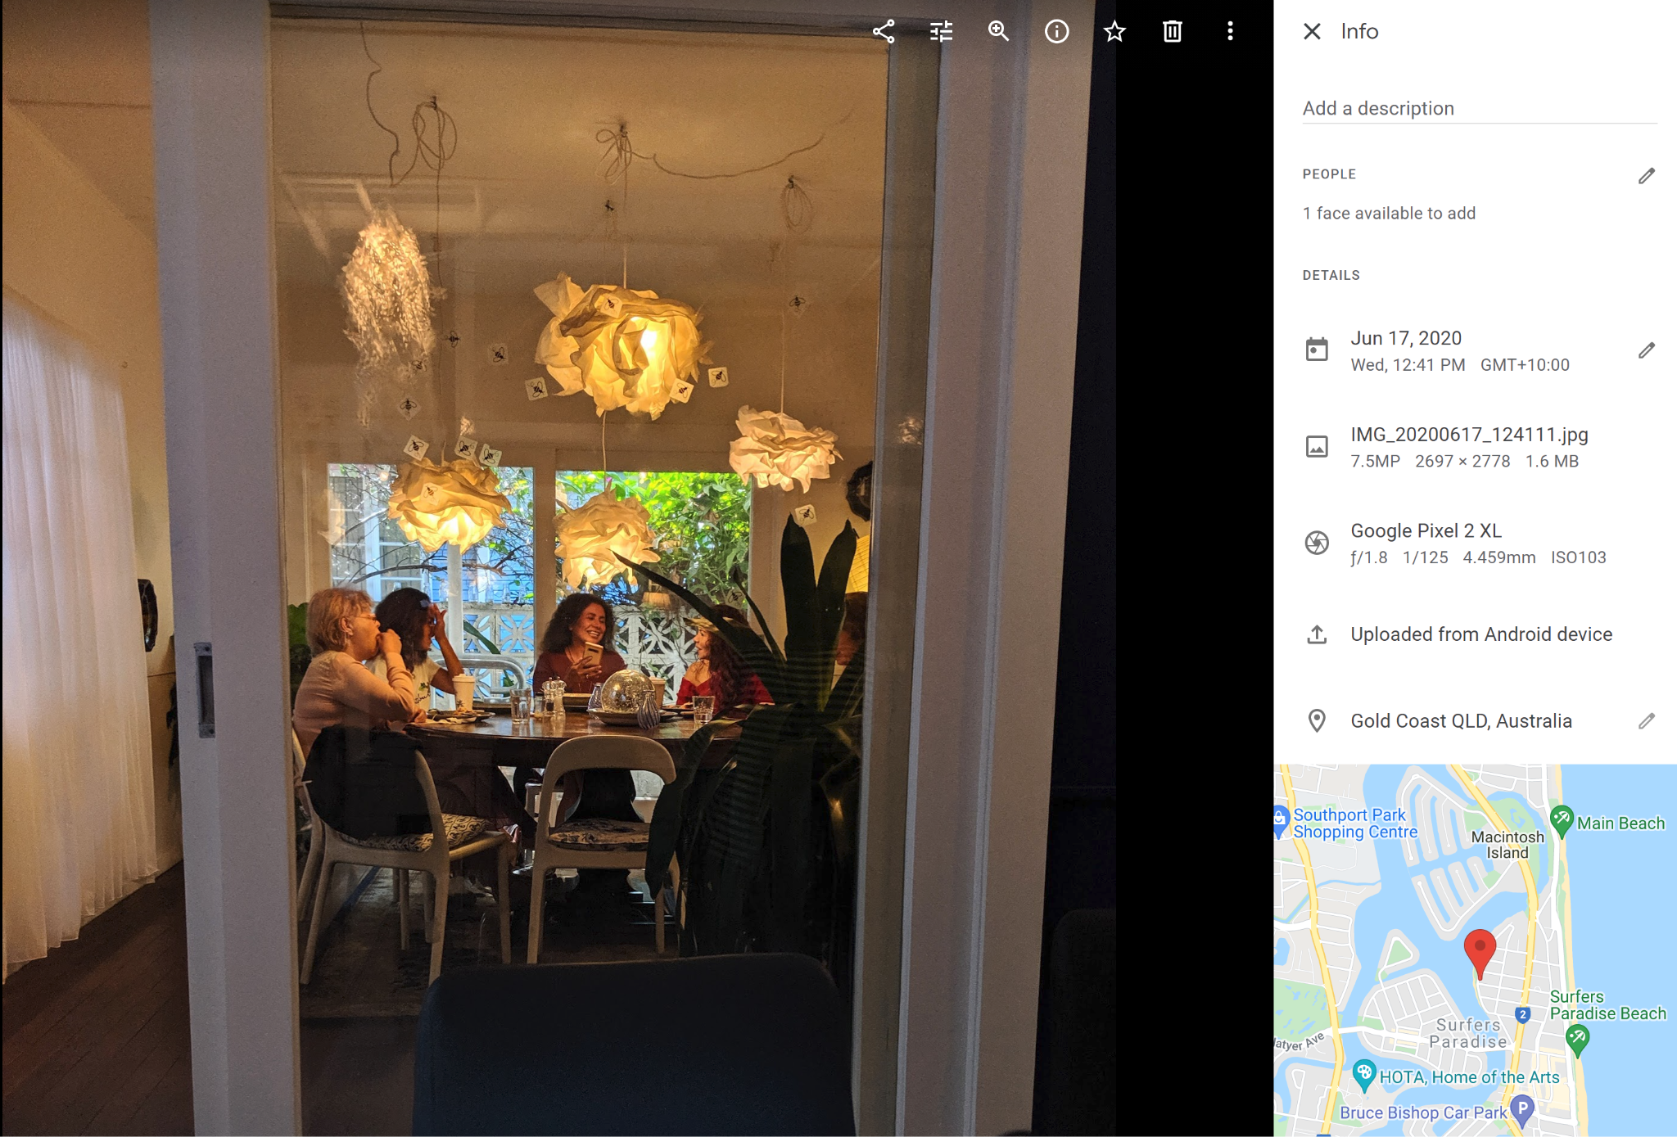
Human in the Loop & Crowdsourcing
Metadata
Geo-location: Gold Coast, QLD, Australia
Time: 6/7/2020 - 12:41pm
Human in the loop data
Who: Mariam
Event: Thanksgiving reunion with family
Age: 39
Notes:
Ideally, we have 2 types of incoming data sources:
Metadata that gets attached to the photo when it is shot (location is turned on in settings)
Human in the Loop data that gets filled out by our family crowdsourcing effort.
For example: you and your relatives can submit media about grandma and fill in the details remembered, this saves us time from using more models to estimate age or life events.

Slide 8
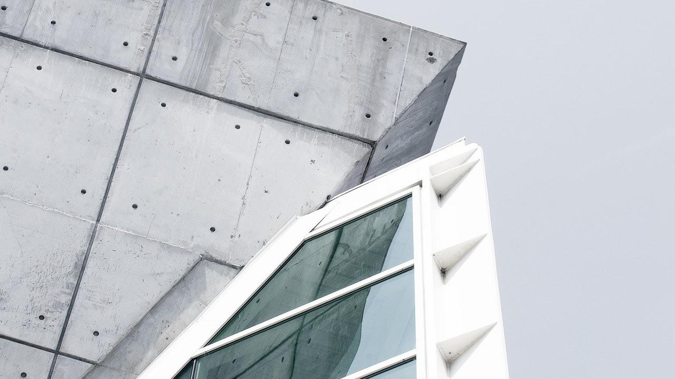

Study Design
Machine Learning and Neural Network Analysis

Slide 9
Deliverables
Phase 1:
Data Collection and Exploratory Data Analysis
Phase 3:
Beta Testing and User Experience
Phase 5:
Project Presentation
Phase 2:
Data Augmentation and Model Tuning
Phase 4:
Final Model and Front End Dev

Slide 10
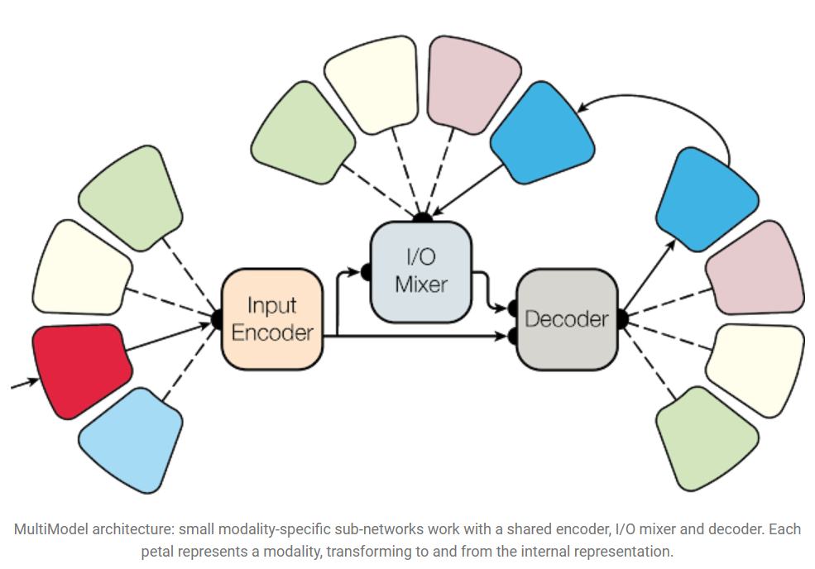
Proposed Model (to be further developed…)
MultiModel: T2T
Sub-networks for audio, images, or text
MultiTasks:
object detection, provide captions, recognize speech
https://ai.googleblog.com/2017/06/multimodel-multi-task-machine-learning.html
Notes:
There are 4 mediums of communication: Images, Text, Audio, Video.
Building a multimodal model that allows people to naturally ask questions across different types of mediums

Slide 11
Methodology
Chronological Algorithm
Media Sentiment Neural Network
Beta Testing
Image Recognition
Age Detection
Life event Detection
Facial Recognition
User Feedback
User feedback through surveys
Improvement

Slide 12
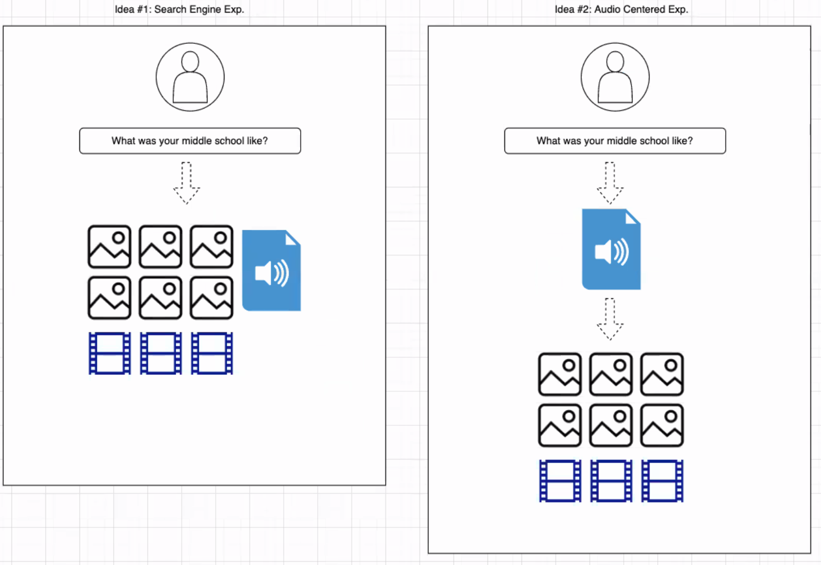
Prototype...

Slide 13
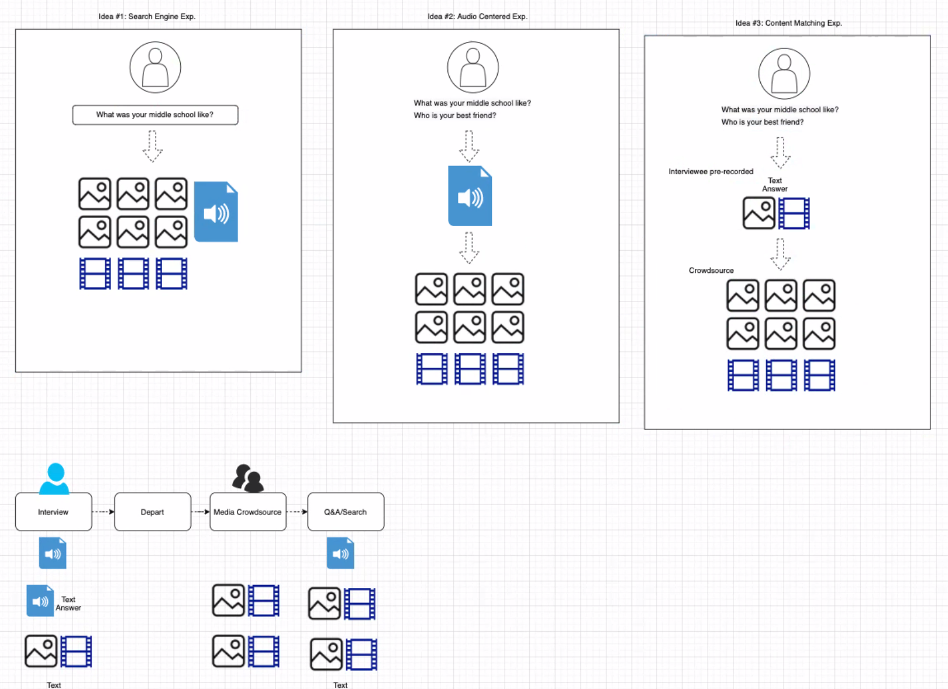

Slide 14
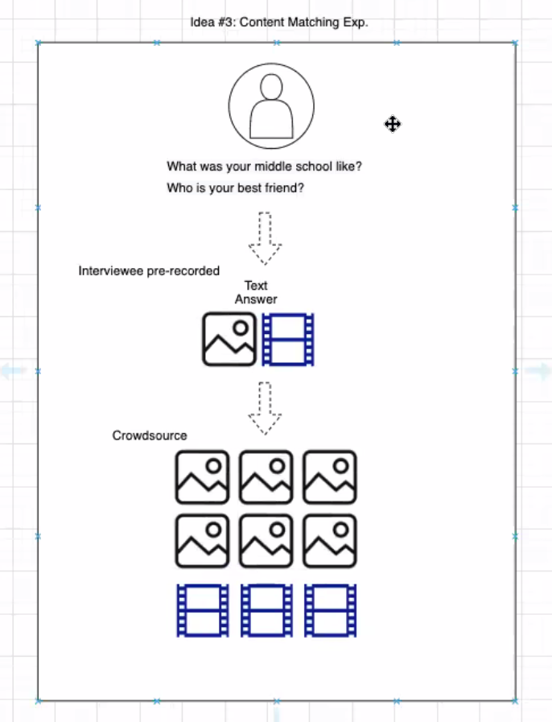
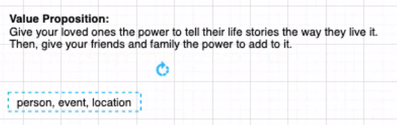
MVP

Slide 15
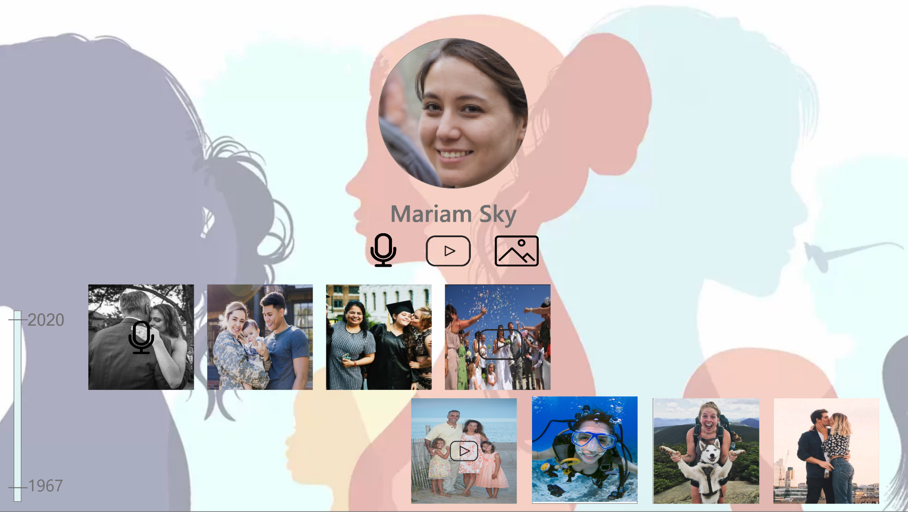
Prototype Preview
Draft made with Adobe XD (to be further refined…)

Slide 16
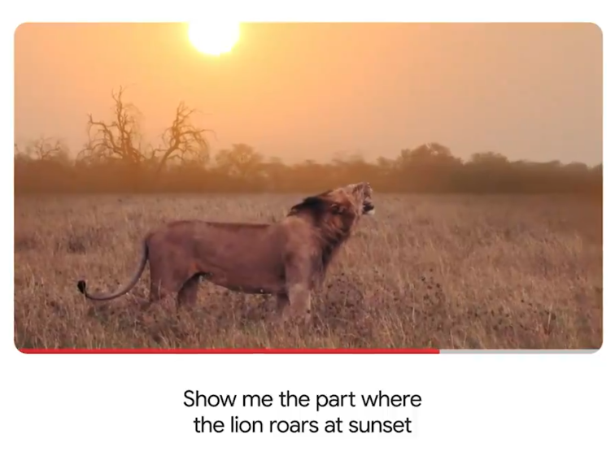
Other feature: voice to media
Except this could be: “Show me Mariam at the Thanksgiving dinner in 1998”
Prototype cont…
https://twitter.com/Google/status/1394826848350113792?s=20

Slide 17

Sensitive Information
Privacy Waiver
Required of All Users
Limited Access ONLY family and authorized users
Privacy checkup every 30 days
Right to request ALL data deletion
Service is active per subscription
Ability to freeze account while preserve legacy (data) across generations

Slide 18
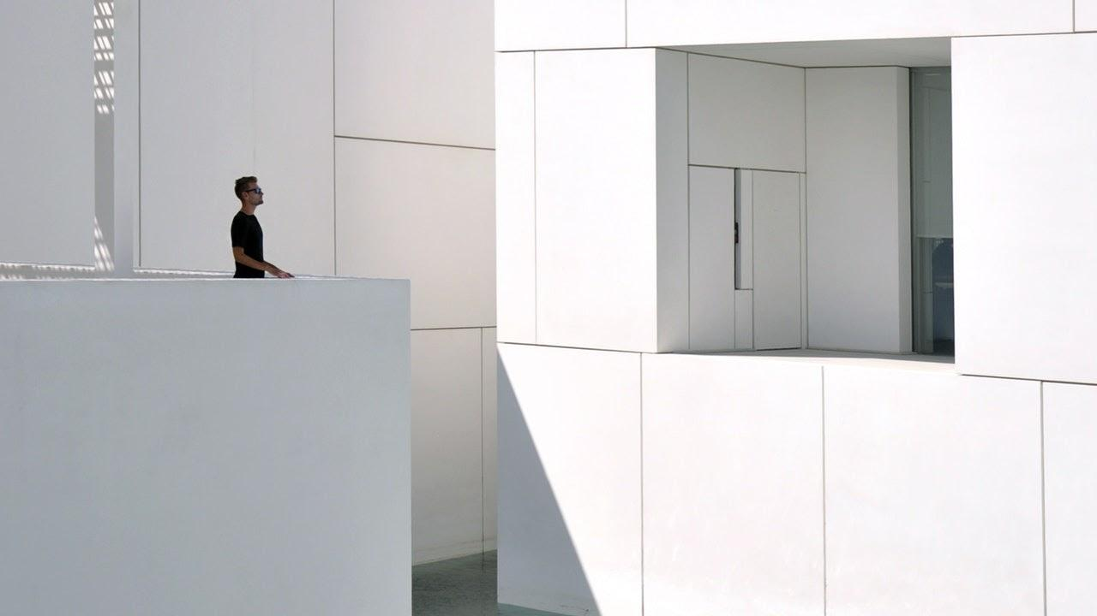
THANKS!
“The most exciting breakthroughs of the 21st century will not occur because of technology but because of an expanding concept of what it means to be human.”
John Naisbitt
Notes:
While the initial service would be costly, our aim is to reach a scale to which it would be affordable for all families.
We think this is an important service that reminds us what’s it like to be human and have human connections.
Thank you. Special thank you to all the team members’ contribution to this research design project.

Slide 19
Related research/products
Hereafter.ai - Berkeley Skydeck startup
MultiModel: Multi-Task Machine Learning Across Domains
StyleGAN2: Data Augmentation
LaMDA: state of the art conversational AI
Sematic Search Engine: Text to image, image to text
Old photos back to life: additional feature
Image harmonization: additional feature
ArcFace: for faces
Current market:
https://www.everplans.com/articles/the-top-10-online-memorial-websites
https://www.google.com/amp/s/deathcareindustry.com/digital-spaces-to-commemorate-loved-ones/amp/

